Slide 1
Office 365 Development

Slide 2
Course Agenda
Introduction to Office 365 Development
Module 1: Deep Dive Apps for Office in Outlook
Module 2: Deep Dive Apps for Office in Word
Module 3: Deep Dive Apps for Office in PowerPoint
Module 4: Deep Dive Apps for Office in Excel
Module 5: Deep Dive into SharePoint Hosted Apps
Module 6: Deep Dive into Provider Hosted Apps
Module 7: Deep Dive into Security and OAuth
Module 8: App Lifecycle Management

Slide 3
Deep Dive into Provider Hosted Apps

Slide 4

Agenda
Introduction
Programming in C#
Remote Event Receivers
Remote “Jobs” and Provisioning

Slide 5
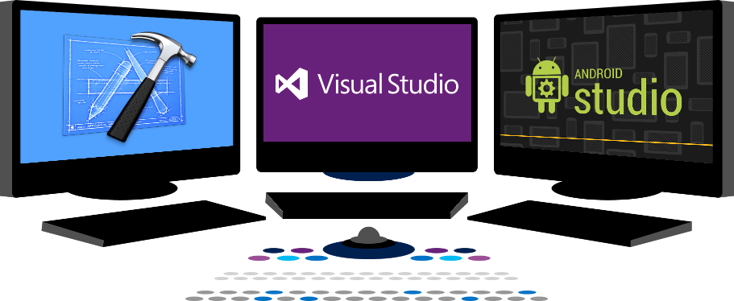














Vision
EXTEND OFFICE EVERYWHERE
CONNECT TO OFFICE 365 SERVICES
BUILD USING AN OPEN PLATFORM
Delve
z
Users and groups
Files
Mail
Calendar
My Apps
Video Portal
Contacts
Office Graph
Presentations
Documents
Spreadsheets
Lync
OneNote
Yammer

Slide 6
Introduction

Slide 7
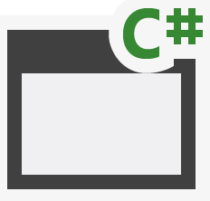
Cloud Architecture
SQL Azure
Azure Web Sites
Azure Data Market
aspx
png
master
CSS
js
SharePoint Online
Host Web
App Web

Slide 8
On-Premises Architecture
Internet Information Server
Databases
Web Services
aspx
png
master
CSS
js
SharePoint 2013
Host Web
App Web

Slide 9
Add-in Permissions
Remote web always has full rights to add-in web
Add-in permissions are the lesser of user and add-in permissions to the given resource
Provider-hosted add-ins can utilize “app-only” permissions to “elevate” privileges.

Slide 10
App-Only Permissions
Considers add-in permissions only, ignores user
Set AllowAppOnlyPolicy to true in add-in manifest
Get an app-only token
Notes:
Provider-hosted apps can use “app only” permissions
Update the App manifest to indicate this is OK
Then you need an app-only token in code

Slide 11
Creating Provider-Hosted Add-ins
Web Project
ASP.NET Web Forms
MVC 5
Authorization
Azure Access Control Services
Server-to-Server High Trust
Programmability
SharePointContextProvider class
Managed CSOM or REST
JavaScript Cross-Domain Library
Notes:
Visual Studio supports both ASP.NET Web Forms and MVC5
On-premises authorization uses S2S
Cloud authorization uses OAuth
The SharePointContextProvider simplifies token management
Managed CSOm and RESt can be used directly from the server side
The cross-domain library can be used from JavaScript

Slide 12
demo
Creating a Provider-Hosted App
Notes:
Create a basic provider hosted app

Slide 13
Programming in C#

Slide 14
SharePointContextProvider Class
Checks for valid Context Token
Redirects if it does not exist
Simplifies the management of context
Provides an ACS or STS context
Context exposes properties for key values like Host Web URL
Simplifies the management of tokens
Context exposes methods to retrieve tokens
Notes:
The SharePointContextProvider simplifies the management of context, and tokens
It uses a cookie to store the CacheKey, and stores the actual token in session state on the server referenced by the cache key
All of this improves performance and makes programming easier

Slide 15
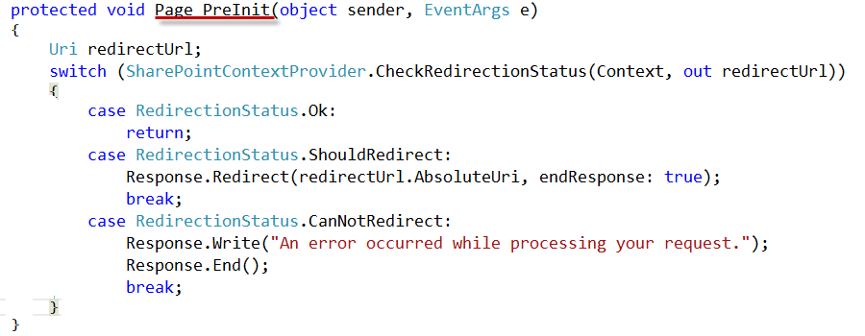
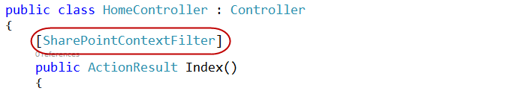
Validating Context Token
Web Forms
MVC 5
Notes:
ASP.NET Web Forms uses the PreInit method to validate the Context Token
Notice how it will redirect if the token is not valid
ASP.NET MVC 5 uses a filter to run essentially the same code
Notice how the filter attribute is applied to the controller

Slide 16
Managing SharePoint Context
SharePointContextProvider GetSharePointContext
Returns SharePointAcsContext in cloud
Returns SharePointHighTrustContext on premises
Properties
SPAppWebUrl
SPClientTag
SPHostUrl
SPLanguage
SPProductNumber
Notes:
SharePointAcsContext and SharePointHightTrustContext both inherit from SharePointContext
This means that the same code works in both cloud and on-premises environments

Slide 17
Managing Security Tokens
CSOM
CreateAppOnlyClientContextForSPAppWeb
CreateAppOnlyClientContextForSPHost
CreateUserClientContextForSPAppWeb
CreateUserClientContextForSPHost
REST
AppOnlyAccessTokenForSPAppWeb
AppOnlyAccessTokenForSPHost
UserAccessTokenForSPAppWeb
UserAccessTokenForSPHost
Notes:
The SharePointContext makes it easy to get the tokens you need

Slide 18
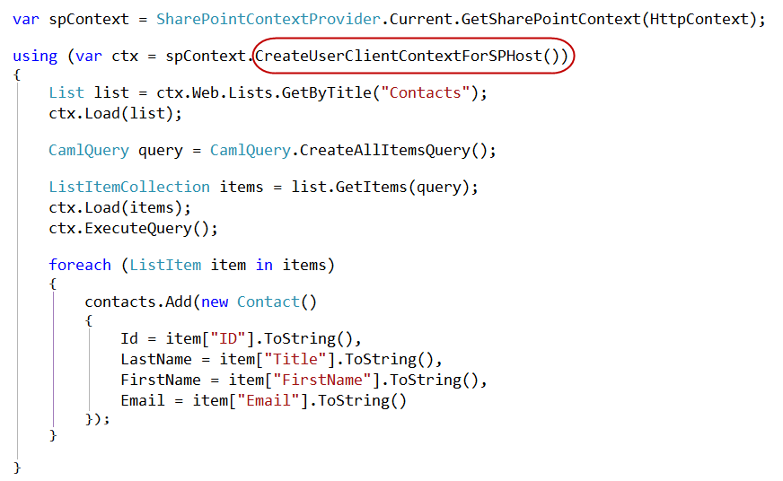
Managed CSOM

Slide 19
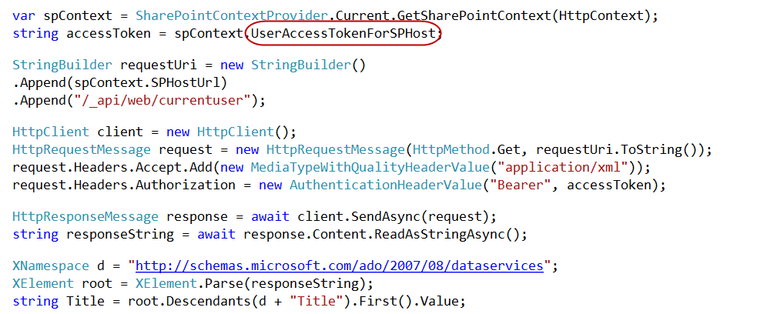
Managed REST

Slide 20
Remote Event Receivers

Slide 21
Remote Event Handlers
Event Handler code runs in remote web
Deployed as web service in remote web
Two-way events
“Before” events (a.k.a, “ING” events)
Synchronous call
Supports a return value
One-way events
“After” events (a.k.a, “ED” events)
Asynchronous call
No return value
Notes:
The event handler infrastructure follows the same pattern as the in-process handlers of old
We have both “before” and “after” event
These are also known as “ING” and “ED” events like “ItemAdding” and “ItemAdded”
Two-way events are synchronous

Slide 22
Supported Events
 | Site | List | List Schema | List Item | App
Create | X | X | X | X
Update |  |  | X | X
Delete | X | X | X | X
Move | X |  |  | X
Check-In |  |  |  | X
Uncheck-In |  |  |  | X
Check-out |  |  |  | X
Attachments |  |  |  | X
File Move/Convert |  |  |  | X
Install |  |  |  |  | X
Uninstall |  |  |  |  | X
Update |  |  |  |  | X

Slide 23
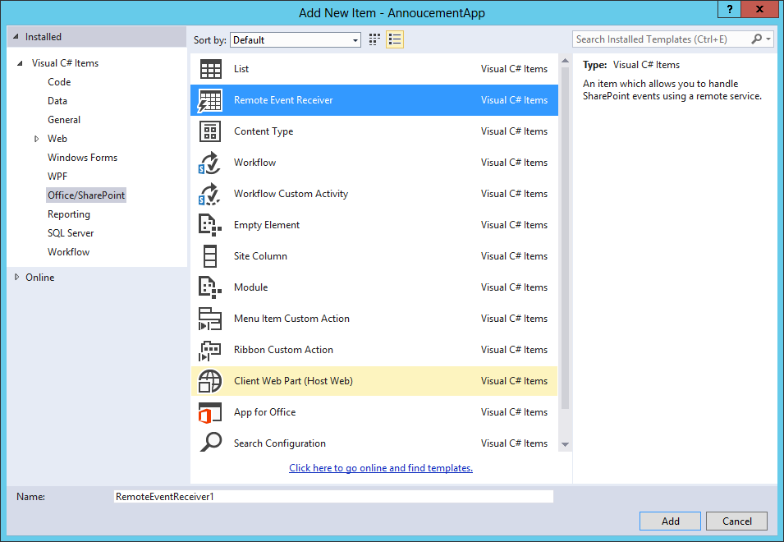
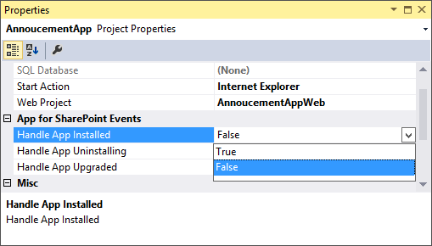
Adding a Remote Event Receiver
Use the “Add New” dialog
For Site, List, Item, and
Schema events
Use the “Properties” dialog
for App events

Slide 24
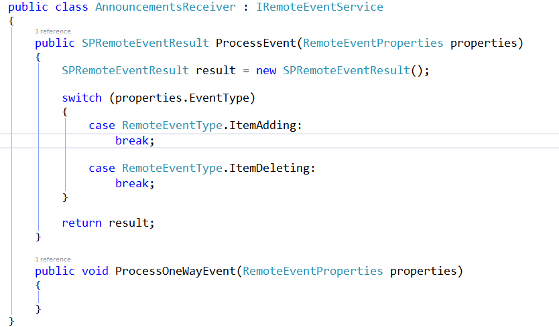
IRemoteEventService
Must be implemented by the remote web service

Slide 25
SPRemoteEventProperties
Passed to web service in response to event
Provides contextual information
Supports reading and updating user inputs
Allows for data validation

Slide 26
SPRemoteEventResult
Returns by two-way events
Allows events to be cancelled
Allows status to be returned

Slide 27
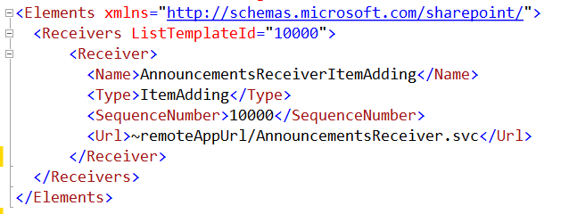
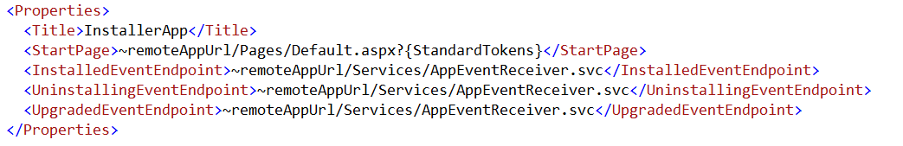
Registering Events Receivers
CAML Element for Lists, Items, Sites, Schema events
App Manifest for
App events

Slide 28
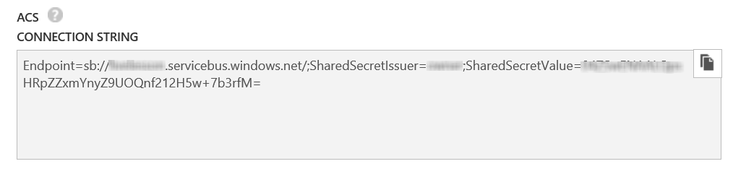
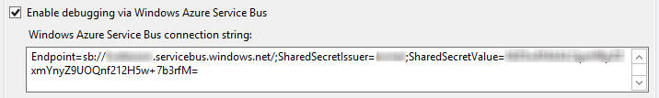
Debugging Considerations
Remote Event Receivers might require Azure Service Bus to support debugging
Create a Service Bus Namespace
Copy the Connection String into the SharePoint Project Properties
Notes:
Note that as of this writing, the Visual tooling only supports ACS strings
The Azure interface only creates SAS strings
So, you have to use PowerShell
Download and Install Azure PowerShell environment
Open PS window
Add-AzureAccount to sign in
New-AzureSBNamespace –Name “myns” -Location “Central US”
Results in an ACS string copy this to Visual Studio

Slide 29
demo
Remote Event Receivers

Slide 30
Remote “Jobs” and Provisioning

Slide 31
Remote “Jobs”…Authentication
SharePointOnlineCredentials
Run with a service account that will operate with permissions of the account char[] pwdChars = ConfigurationManager.AppSettings["AccountPassword"].ToCharArray(); System.Security.SecureString pwd = new System.Security.SecureString(); for (int i = 0; i < pwdChars.Length; i++) pwd.AppendChar(pwdChars[i]); ClientContext cc = new ClientContext(siteUri); cc.AuthenticationMode = ClientAuthenticationMode.Default; cc.Credentials = new SharePointOnlineCredentials(ConfigurationManager.AppSettings["AccountUsername"], pwd);
ClientContext
Runs with the permissions defined in the app permissions //Get the realm for the URL string realm = TokenHelper.GetRealmFromTargetUrl(siteUri); //Get the access token for the URL. Requires this app to be registered with the tenant string accessToken = TokenHelper.GetAppOnlyAccessToken(TokenHelper.SharePointPrincipal, siteUri.Authority, realm).AccessToken; //Get client context with access token using (var clientContext = TokenHelper.GetClientContextWithAccessToken(siteUri.ToString(), accessToken)) {

Slide 32
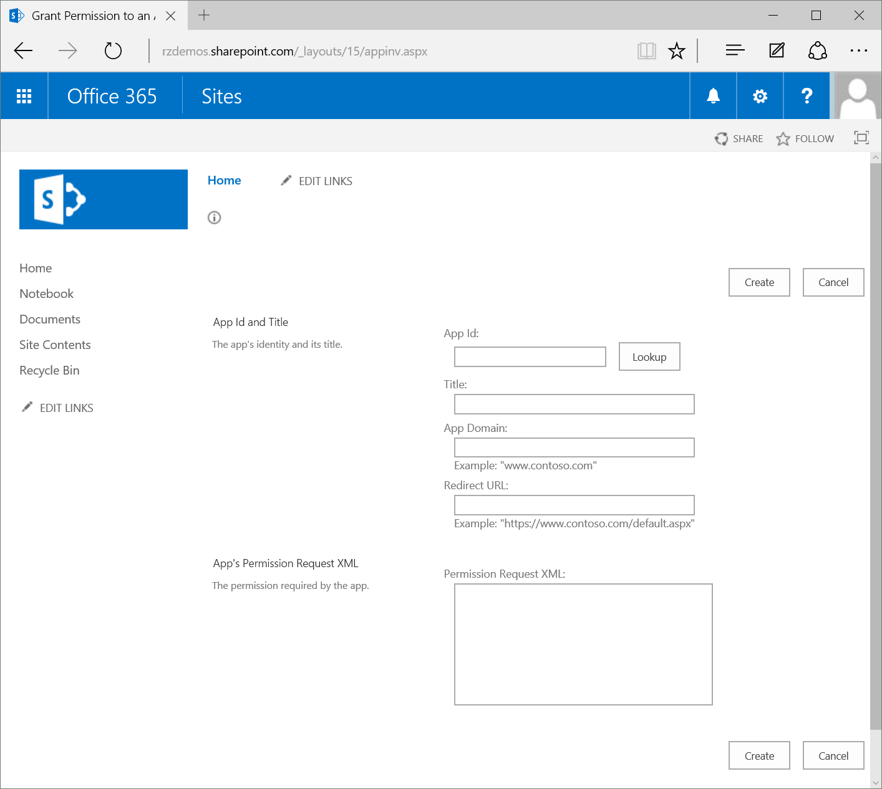
Remote “Jobs”…Authentication
AppInv.aspx
Used to grant permissions to an application without a User Interface
Application must first be registered via AppRegNew.aspx
Copy Permissions block from manifest into “App’s Permission Request XML” field

Slide 33
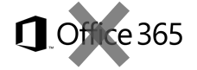

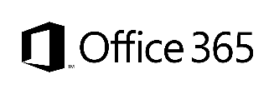
Provisioning Options/Comparison
Site Definition
Site Templates
Web Templates
SP Server side provisioning
Remote provisioning
No Office365
Long term impact on costs
Blocks transition to cloud
Causes significant issues with future migration and upgrade
Poor site collection creation story
Negative impact on upgrades
Causes additional maintenance costs with service updates
Not with publishing features
Poor site collection creation story
Causes maintenance costs with service updates
Provision oob sites, but modify them based on user selection and requirements
Standardization of site creation in code
No Office365
CSOM supports creation of site collections for on-premises and cloud
Standardization of site creation in code
Can be done from any external system
Options
Support in cloud
Options available
Good
Fair
Average
Good
Excellent
Cost impact (short and long term)
Notes:
Vesa
For more information on provisioning sites and associated terminology see:
SharePoint 2010 and web templates, http://blogs.msdn.com/b/vesku/archive/2010/10/14/sharepoint-2010-and-web-templates.aspx
Site provisioning techniques and remote provisioning in SharePoint 2013, http://blogs.msdn.com/b/vesku/archive/2013/08/23/site-provisioning-techniques-and-remote-provisioning-in-sharepoint-2013.aspx

Slide 34

Site Collection Creation from add-ins
What
Provision new site collections from add-in side
Why
Can be used to override out–of–the–box self-service site collection creation form
Can be used to integrate additional functionalities as part of the provisioning
How
Office365 has separate downloadable that includes the needed CSOM elements to provision sites
After 2014 April CU, natively supported for on-prem as well.
Notes:
Vesa

Slide 35
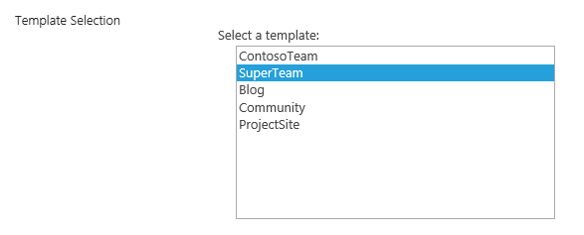
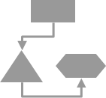
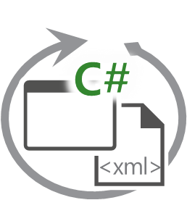
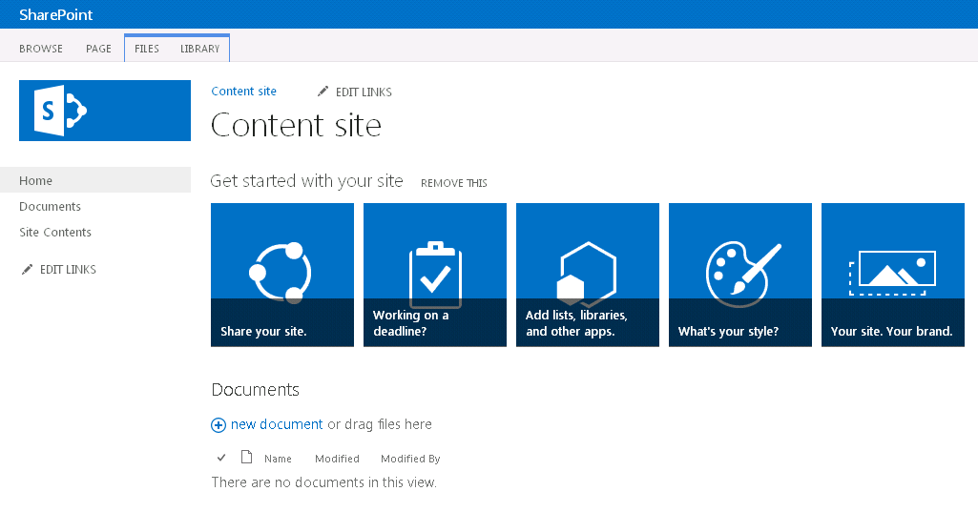
Async provisioning model
Provider Hosted add-ins
2
SharePoint Service
1
3
4
6
Remote timer job
5
https://contoso.sharepoint.com /sites/site
Notes:
Vesa

Slide 36
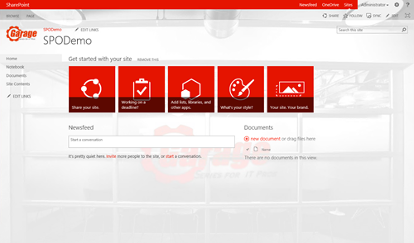
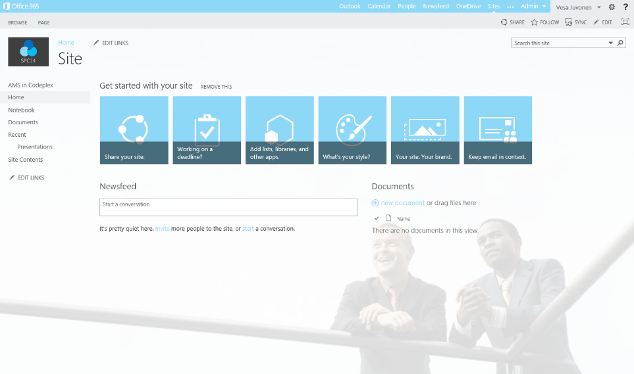
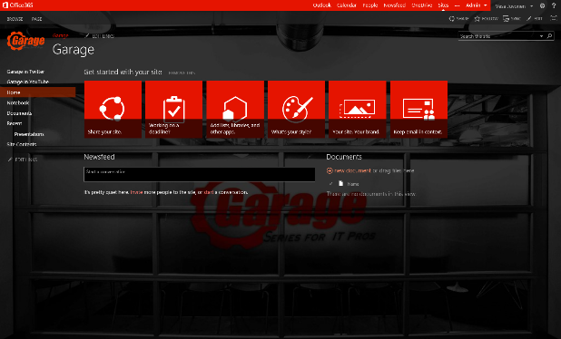
Provisioning time logic
Initial provisioning based on the out of the box site. Usually either team site or publishing site.
Assets are uploaded from the provisioning engine using CSOM/REST
3
Project site
1
2
Remote timer job
3
Assets and configuration
Organizational
Apply the needed changes (configurations etc.) on top of the out of the box site based on the user selection.
This is the specialization part, but since we start from oob site, we always get the latest improvements to it as a base line.
Branding Images
Master Pages
Page Layouts
Other settings
3
Workgroup
Notes:
Vesa

Slide 37
demo
Remote Jobs and Provisioning

Slide 38
Summary
Introduction
Programming in C#
Remote Event Receivers
Remote “Jobs” and Provisioning

Slide 39



dev.office.com
Sign up
http://dev.office.com/getting-started
Explore
http://apisandbox.msdn.microsoft.com
Get trained http://dev.office.com/training

Slide 40


Feedback
Office 365 Network Share you best practices and join conversations https://www.yammer.com/itpronetwork
Stackoverflow Ask deep technical questions to a world-wide set of developers
http://stackoverflow.com/questions/tagged/ms-office
UserVoice Provide suggestions of what you want in future versions
http://officespdev.uservoice.com/

Slide 41

© 2012 Microsoft Corporation. All rights reserved. Microsoft, Windows, and other product names are or may be registered trademarks and/or trademarks in the U.S. and/or other countries.
The information herein is for informational purposes only and represents the current view of Microsoft Corporation as of the date of this presentation. Because Microsoft must respond to changing market conditions, it should not be interpreted to be a commitment on the part of Microsoft, and Microsoft cannot guarantee the accuracy of any information provided after the date of this presentation. MICROSOFT MAKES NO WARRANTIES, EXPRESS, IMPLIED OR STATUTORY, AS TO THE INFORMATION IN THIS PRESENTATION.

